Slide 1



TOKENS

Slide 2
TOKEN VS TERMINALS
In a compiler, the lexical analyzer reads the characters of the source program, groups them into lexically meaningful units called lexemes, and produces as output tokens representing these lexemes. A token consists of two components, a token name and an attribute value. The token names are abstract symbols that are used by the parser for syntax analysis. Often, we shall call these token names terminals, since they appear as terminal symbols in the grammar for a programming language. The attribute value, if present, is a pointer to the symbol table that contains additional information about the token. This additional information is not part of the grammar, so in our discussion of syntax analysis, often we refer to tokens and terminals synonymously.

Slide 3
Specification And Recognition Of Tokens
Token:
In programming language, keyboards, constants, identifiers, strings, numbers, and punctuations symbols can be considered as tokens.
For example, in C language, the variable declaration line
int value = 100;
Contains the tokens:
int (keyword), value (identifier), =(operator), 100(constant) and ;(symbol).

Slide 4
Specifications Of Tokens
Definitions:
The alphabet (often written E) is the set of legal input symbols
A STRING over some alphabet E is a finite sequence of symbols from E
The length of string s is written |s|
The empty STRING is a special 0-length string denoted ἐ
REGULAR EXPRESSION (REs) are the most common notation for pattern specification.
Every pattern specifies a set of strings, so an RE names a set of strings.

Slide 5
Specifications Of Tokens
Alphabets
Any finite set of symbols {0,1} is a set of binary alphabets, {0,1,2,3,4,5,6,7,8,9,A,B,C,D,E,F} is a set of Hexadecimal alphabets, {a-z, A-Z} is a set of English language alphabets.
Strings
Any finite sequence of alphabets is called a string. Length of the string is the total number of occurrence of alphabets, e.g., the length of the string tutorialspoint is 14 and is denoted by |tutorialspoint| = 14. A string having no alphabets, i.e. a string of zero length is known as an empty string and is denoted by ε (epsilon).

Slide 6
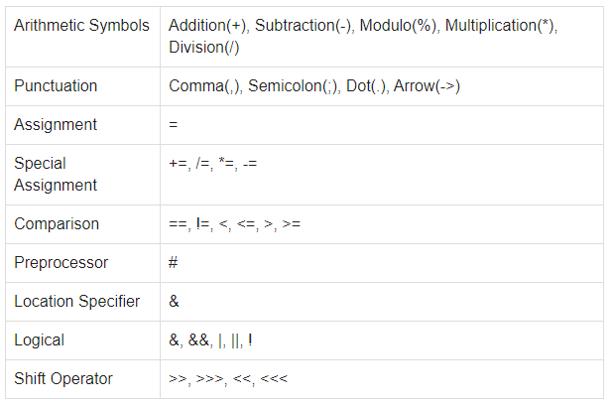
Specifications Of Tokens
Special Symbols
A typical high-level language contains the following symbols

Slide 7
Specifications Of Tokens
Language
A language is considered as a finite set of strings over some finite set of alphabets. Computer languages are considered as finite sets, and mathematically set operations can be performed on them. Finite languages can be described by means of regular expressions.

Slide 8
Specifications Of Tokens
Regular Expressions
The lexical analyzer needs to scan and identify only a finite set of valid string/token/lexeme that belong to the language in hand. It searches for the pattern defined by the language rules.
Regular expressions have the capability to express finite languages by defining a pattern for finite strings of symbols. The grammar defined by regular expressions is known as regular grammar. The language defined by regular grammar is known as regular language.

Slide 9
Specifications Of Tokens
Regular Expressions
Regular expression is an important notation for specifying patterns. Each pattern matches a set of strings, so regular expressions serve as names for a set of strings. Programming language tokens can be described by regular languages. The specification of regular expressions is an example of a recursive definition. Regular languages are easy to understand and have efficient implementation.
There are a number of algebraic laws that are obeyed by regular expressions, which can be used to manipulate regular expressions into equivalent forms.

Slide 10
Specifications Of Tokens
Operations On Language
The various operations on languages are:
Union of two languages L and M is written as
L U M = {s | s is in L or s is in M}
Concatenation of two languages L and M is written as
LM = {st | s is in L and t is in M}
The Kleene Closure of a language L is written as
L* = Zero or more occurrence of language L.

Slide 11
Specifications Of Tokens
Notations
If r and s are regular expressions denoting the languages L(r) and L(s), then
Union : (r)|(s) is a regular expression denoting L(r) U L(s)
Concatenation : (r)(s) is a regular expression denoting L(r)L(s)
Kleene closure : (r)* is a regular expression denoting (L(r))*
(r) is a regular expression denoting L(r)

Slide 12
Specifications Of Tokens
Precedence And Associativity
*, concatenation (.), and | (pipe sign) are left associative
* has the highest precedence
Concatenation (.) has the second highest precedence.
| (pipe sign) has the lowest precedence of all.

Slide 13
Specifications Of Tokens
Representing valid tokens of a language in regular expression
If x is a regular expression, then:
x* means zero or more occurrence of x.
i.e., it can generate { e, x, xx, xxx, xxxx, … }
x+ means one or more occurrence of x.
i.e., it can generate { x, xx, xxx, xxxx … } or x.x*
x? means at most one occurrence of x
i.e., it can generate either {x} or {e}.
[a-z] is all lower-case alphabets of English language.
[A-Z] is all upper-case alphabets of English language.
[0-9] is all natural digits used in mathematics.

Slide 14
Specifications Of Tokens
Representing occurrence of symbols using regular expression
letter = [a – z] or [A – Z]
digit = 0 | 1 | 2 | 3 | 4 | 5 | 6 | 7 | 8 | 9 or [0-9]
sign = [ + | - ]
Representing language tokens using regular expression
Decimal = (sign)?(digit)⁺
Identifier = (letter)(letter | digit)*
The only problem left with the lexical analyzer is how to verify the validity of a regular expression used in specifying the patterns of keywords of a language. A well-accepted solution is to use finite automata for verification.

Slide 15
Terms for Parts of Strings
The following string-related terms are commonly used:
1. A prefix of string S is any string obtained by removing zero or more symbols from the end of s. For example, ban, banana, and E are prefixes of banana.
2. A suffix of string s is any string obtained by removing zero or more symbols from the beginning of s. For example, nana, banana, and E are suffixes of banana.
3. A substring of s is obtained by deleting any prefix and any suffix from s. For instance, banana, nan, and E are substrings of banana.

Slide 16
Terms for Parts of Strings
4. The proper prefixes, suffixes, and substrings of a string s are those, prefixes, suffixes, and substrings, respectively, of s that are not E or not equal to s itself.
5. A subsequence of s is any string formed by deleting zero or more not necessarily consecutive positions of s. For example, baan is a subsequence of banana

Slide 17
Regular Expressions
• REs let us precisely define a set of strings.
• For C identifiers, we might use letter ( letter | digit )*
• Parentheses are for grouping, | means “OR”, and * means zero or more instances.
• Every RE ‘r’ defines a language L(r).

Slide 18
REGULAR EXPRESSION
• Here are the rules for writing REs over an alphabet ∑ :
ε is an RE denoting { ε }, the language containing only the empty string.
If ‘a’ is in ∑, then a is a RE denoting { a }.
If r and s are REs denoting L(r) and L(s), then
(r)|(s) is a RE denoting L(r) ∪ L(s)
(r)(s) is a RE denoting L(r) L(s)
(r)* is a RE denoting (L(r))*
(r) is a RE denoting L(r)

Slide 19
ADDITIONAL CONVENTIONS
• To avoid too many parentheses, we assume:
* has the highest precedence, and is left associative.
Concatenation has the 2nd highest precedence, and is left associative.
| has the lowest precedence and is left associative.

Slide 20
EXAMPLES OF REGULAR EXPRESSION
a | b
(a | b) (a | b)
a*
(a | b)*
a | a*b

Slide 21
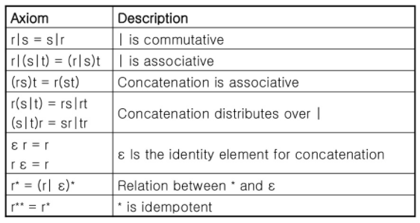
Equivalence of REs

Slide 22
Extensions of Regular Expressions
Since Kleene introduced regular expressions with the basic operators for union, concatenation, and Kleene closure in the 1950s, many extensions have been added to regular expressions to enhance their ability to specify string patterns. Here we mention a few notational extensions that were first incorporated into Unix utilities such as Lex that are particularly useful in the specification lexical analyzers. The references to this chapter contain a discussion of some regular expression variants in use today.

Slide 23
Extensions of Regular Expressions
2. Zero or one instance. The unary postfix operator ? means "zero or one occurrence." That is, r? is equivalent to rl E, or put another way, L(r?) = L(r) U {c}. The ? operator has the same precedence and associativity as * and +.

Slide 24
Extensions of Regular Expressions
3. Character classes. A regular expression al la2 1 · · · Ian , where the ai 's are each symbols of the alphabet, can be replaced by the shorthand [ala2 ··· an] . More importantly, when aI , a2, . ·· , an form a logical sequence, e.g., consecutive uppercase letters, lowercase letters, or digits, we can replace them by aI-an, that is, just the first and last separated by a hyphen. Thus, [abc] is shorthand for albic, and [a-z] is shorthand for albl··· lz.

Slide 25


Extensions of Regular Expressions
Using these short hands, we can rewrite the regular definition of
As:

Slide 26


Extensions of Regular Expressions
Using these short hands, we can rewrite the regular definition of
As:

Slide 27
Extensions of Regular Expressions
1. One or more instances. The unary, postfix operator + represents the positive closure of a regular expression and its language. That is, if r is a regular expression, then (r)+ denotes the language (L(r)) +. The operator + has the same precedence and associativity as the operator *. Two useful algebraic laws, r* = r+ Ie and r+ = rr* = r*r relate the Kleene closure and positive closure.

Slide 28
REGULAR DEFINITIONS
• Example for identifiers in C:
letter -> A | B | … | Z | a | b | … | z
digit -> 0 | 1 | … | 9
id -> letter ( letter | digit )*
• Example for numbers in Pascal:
digit -> 0 | 1 | … | 9
digits -> digit digit*
optional_fraction -> . digits | ε
optional_exponent -> ( E ( + | - | ε ) digits ) | ε
num -> digits optional_fraction optional_exponent

Slide 29
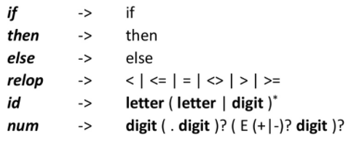
Recognition Of Tokens
We now know how to specify the tokens for our language. But how do we write a program to recognize them

Slide 30

Token recognition
We also want to strip whitespace, so we need definitions

Slide 31
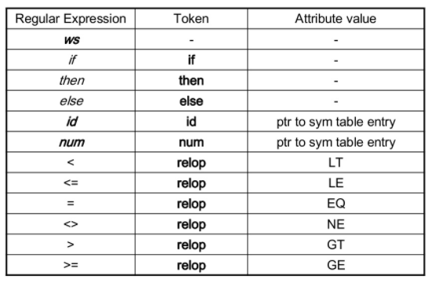
Tokens, Patterns, And Attribute values

Slide 32
Transition Diagrams
• Transition diagrams are also called finite automata.
• We have a collection of STATES drawn as nodes in a graph.
• TRANSITIONS between states are represented by directed edges in the graph.
• Each transition leaving a state s is labeled with a set of input characters that can occur after state s.

Slide 33
Transition Diagrams
• For now, the transitions must be DETERMINISTIC.
• Each transition diagram has a single START state and a set of TERMINAL STATES.
• The label OTHER on an edge indicates all possible inputs not handled by the other transitions.
• Usually, when we recognize OTHER, we need to put it back in the source stream since it is part of the next token. This action is denoted with a * next to the corresponding state.

Slide 34
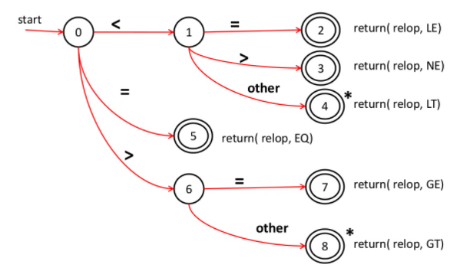
Transition Diagrams
Transition Diagram for relop

Slide 35
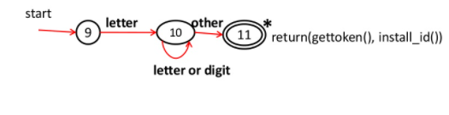
Transition Diagrams
Transition Diagram for id’s and keywords

Slide 36

Transition Diagrams
Transition Diagram for whitespace

Slide 37

Transition Diagrams
Transition Diagram for unsigned numbers

Slide 38
Thank You

